Slide 1
DATABASE PROJECT
NORTHEASTERN ART GALLERY MANAGEMENT

Slide 2
GROUP MEMBERS TEAM 17
NAME | HUSKY ID
ANISH SURTI | 001814243
NILANK SHARMA | 001279669
SIDHARTH UPADHYAY | 001389944

Slide 3
INTRODUCTION
Northeastern Art Gallery Management is a database system that allows buyers to purchase different art styles online/offline. In addition to this, buyers also have the option to buy arts online. It provides various categories too, in buyers’ accordance. It gives privileges to buyers to create their own portfolio.

Slide 4
SCOPE
Northeastern University Art Management, marketing, and sales staff to generate descriptive reports
Buyers don’t have to go to museums and buy from selected art stuff. Also, to give thorough art information to enhance or aware buyers regarding it
Deliver shrewdness to artists and management staff to concentrate on art work by thorough analysis of report and effectively covering age group of users
It will eliminate the delays in the generation of reports that which item has sold to whom and also searching will become more efficient and faster
Permit sales staff to analyze and refine sales quarterly objectives.
It will also provide assurance to the customer that they can buy the art they like there would be no pressure

Slide 5
BUSINESS rules
Each Artist may participate in zero or more Art Exhibitions.
Each Artist may have zero or more Art Work.
Each Art will have one buyer.
Each Exhibition will have start and end date.
Each Gallery will have one or more Employees.
Each Employee, Customer will have one Address.
Each Customer will have one or more Bills.
Each Employee will have one fixed Wage
Each Customer can place one or more orders and each order will have order details.

Slide 6
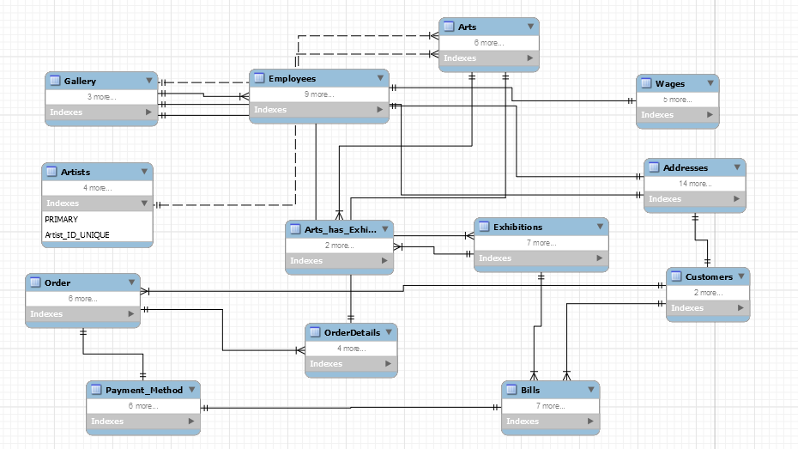
Entity-relationship diagram

Slide 7
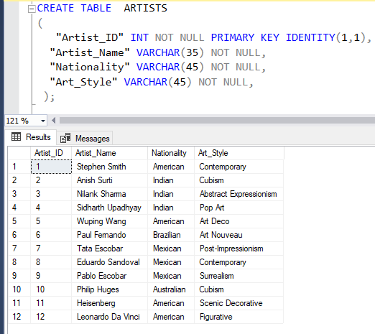
ARTISTS
Artist will be responsible for creating arts which will be showcased in Exhibitions from where customer can buy, so that they can earn money.

Slide 8
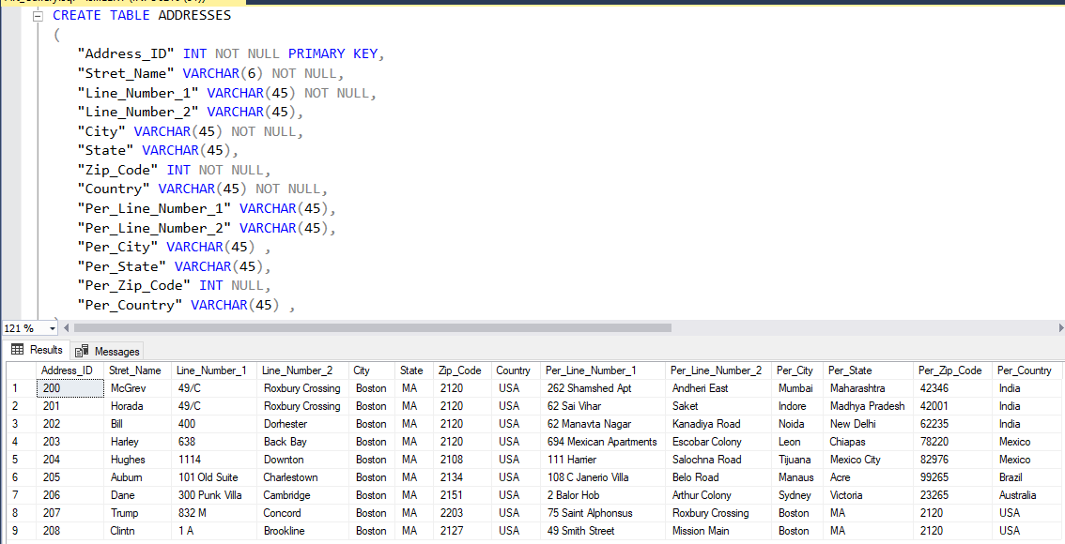
ADDRESSES
Address contains records of all Users. It contains information about street, state, zip code, country etc.

Slide 9
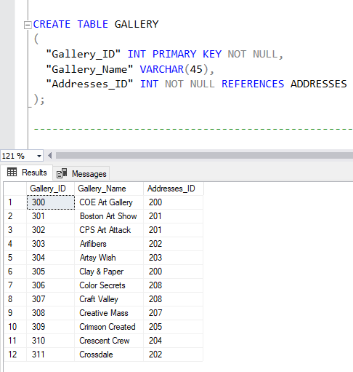
GALLERY
Gallery is the location in University where multiple exhibitions are conducted. Each exhibition displays various Arts made by various Artists. Customers visits Gallery and based on their interest they may or may not buy it.

Slide 10
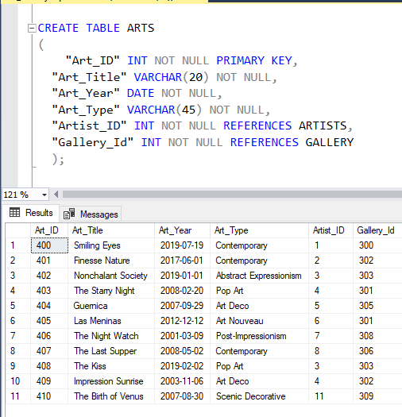
ARTS
The entity stores records of all Arts and their corresponding Artists. An exhibition contains multiple Arts. It also contains information of Gallery where it is held.

Slide 11
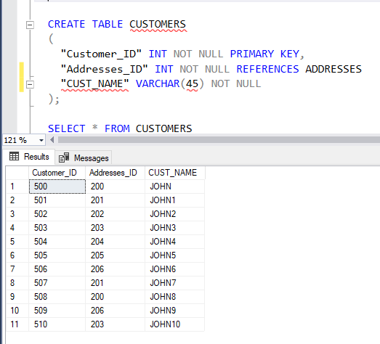
CUSTOMERS
Customer is a subtype of User entity. He/she can buy new artworks of different artists from various exhibitions. Exhibition of various arts are conducted to attract customers.

Slide 12
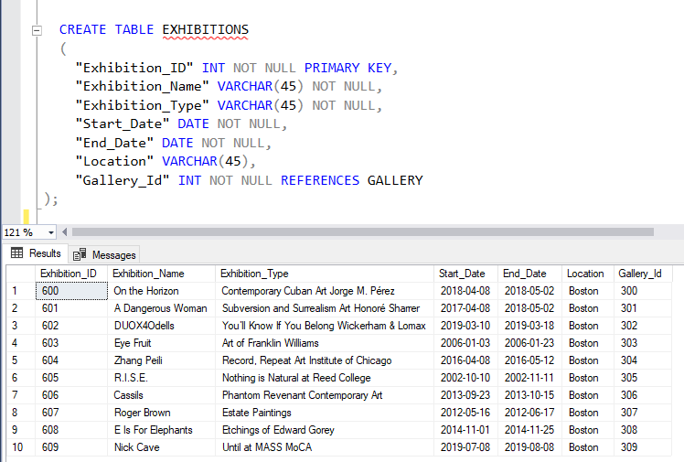
EXHIBITIONS
Exhibitions is held in a Gallery which displays multiple Arts. A gallery can hold multiple exhibitions at different time.

Slide 13
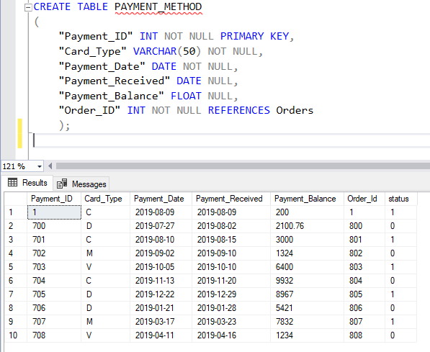
PAYMENT_METHOD
It records all payment related data of customers for an art/arts. A customer can make payment through credit/debit card. The entity also stores related data about all payments.
Status 0 – Payment Not Done
Status 1 – Payment Done

Slide 14
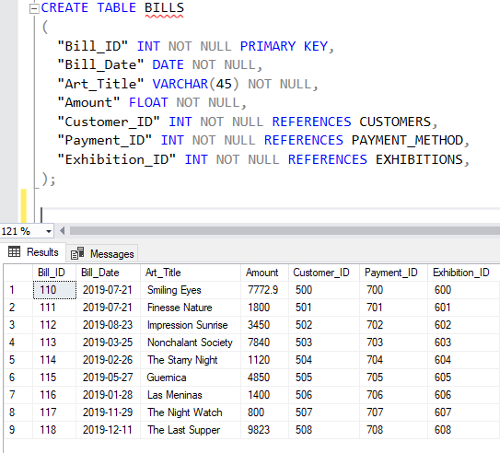
BILLS
Bills are generated when a Customer buys an Art from an Exhibition. It also contains relationship with Payment_Method which stores Debit/Credit Card information made for the Payment.

Slide 15
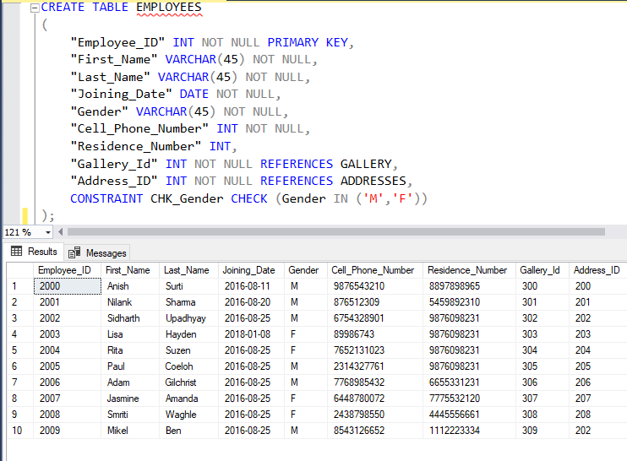
employees
Employees are the people who works in the Gallery. They work on shift basis and they are paid based on number of hours they work.

Slide 16
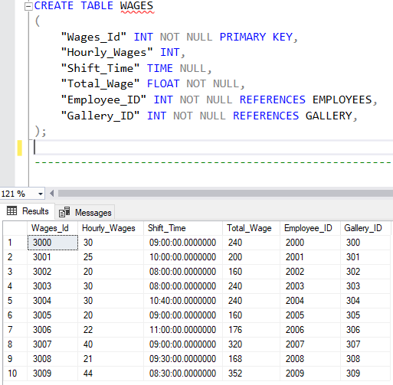
wages
Stores all records related to wages of the employees working in the Gallery. Like their hourly wage, shift time etc.

Slide 17
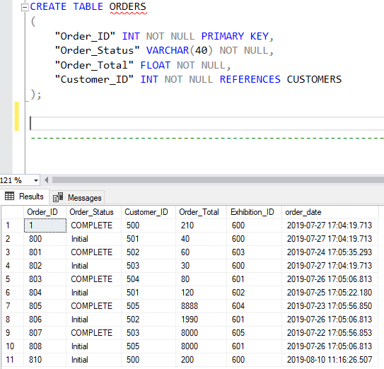
ORDERS
This table stores details of an order with attributes like Order_ID, Order_Status, Customer_ID, Order_Total, Exhibition_ID to correlate Order details with specific customer with status and total amount on an order.

Slide 18
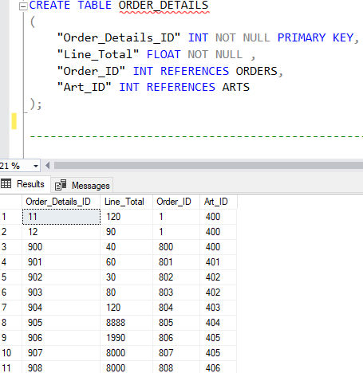
ORDER_DETAILS
This is to contain information on order details with respect to the specific art the order relates to and attributes like line_total and art_id.

Slide 19
QUERIES

Slide 20
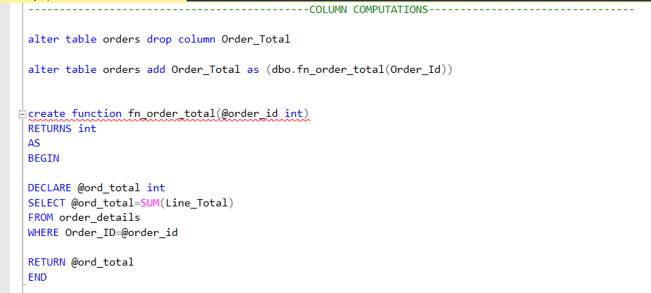
ORDERS
Implemented column computation on the column of Order_Total of ORDERS table.
We calculated the total of orders of a customer by calculating the individual orders belongs to that customer id by using the Line_Total of ORDER_DETAILS table .

Slide 21
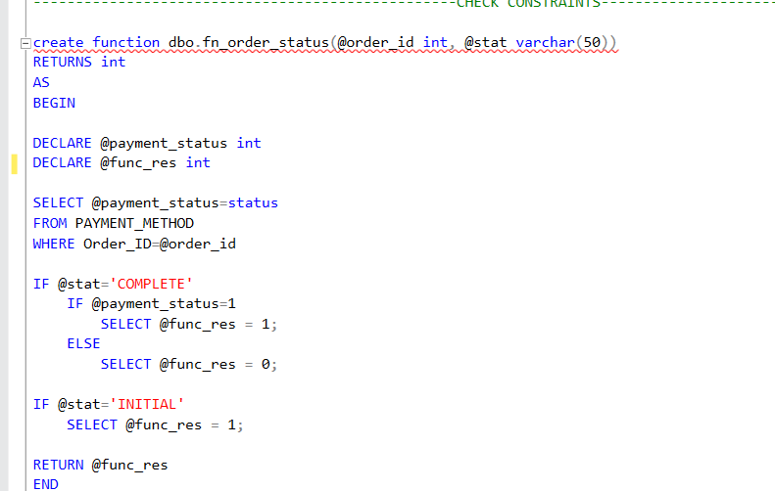
CHECK CONSTRAINTS
Implemented the check constraints on the table ORDERS.
We won’t be able to edit the column Order_Status from ‘Initial’ to ‘Complete’ until and unless the payment_status changes from 0 to 1
To do this we also used the table PAYMENT_METHOD and column ‘status’ of it

Slide 22
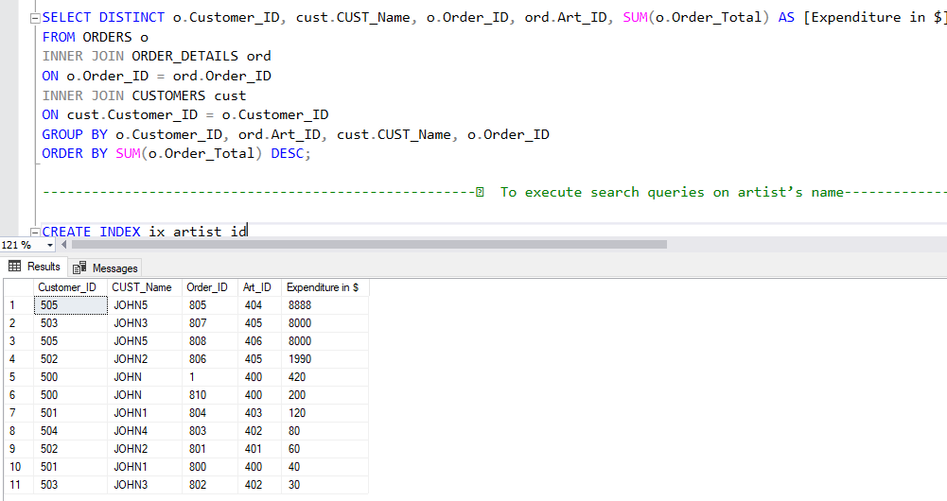
ORDERS, ORDER_DETAILS, CUSTOMERS
To find the sum of expenditures of customers which they spent on an art with their Art_ID and Order_ID
SUM of Order_Total belong to that Order_ID of that Customer_ID

Slide 23
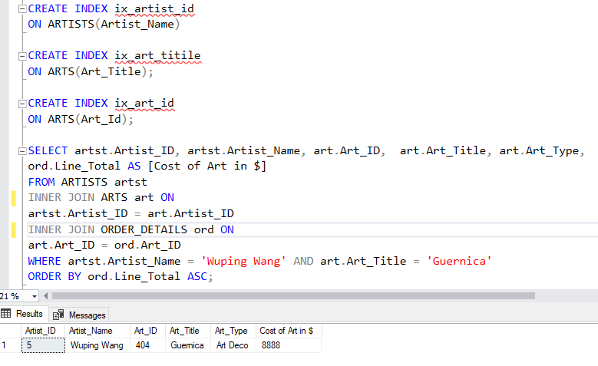
ARTISTS, ARTS, ORDER_DETAILS
Created Index - artists name (ARTISTS), art title (Art Title), art id (Art ID)
To search the art of a particular artists with art title and artists name and display the price of art and type of it.

Slide 24
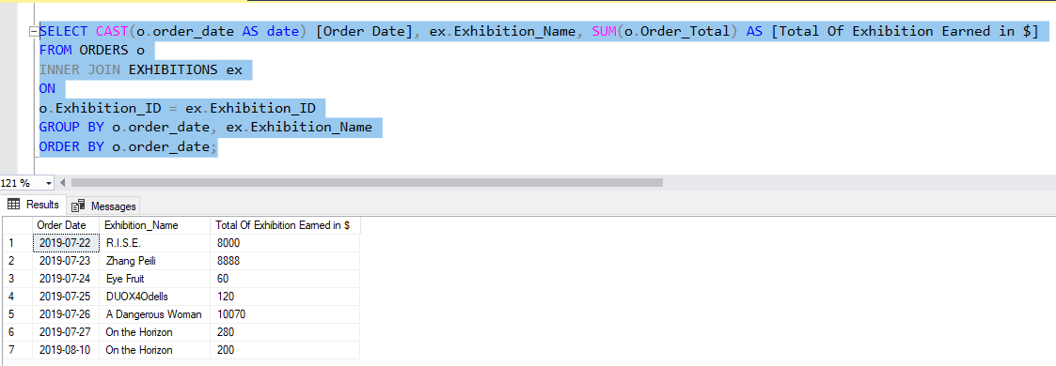
ORDERS, EXHIBITIONS
To calculate the total money earned by the exhibition by exhibition name and date.
Display date, exhibition name, money earned by it in the report

Slide 25
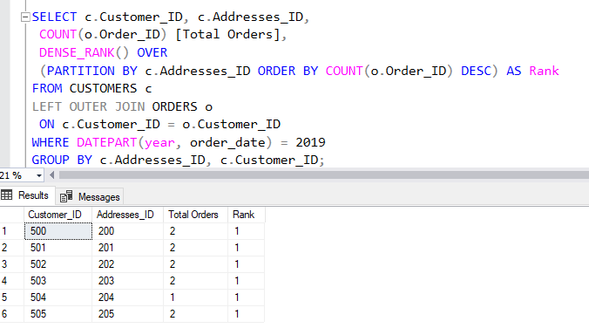
CUSTOMERS, ORDERS
To add a rank without gaps in the ranking based on total orders in the descending order partition by address

Slide 26
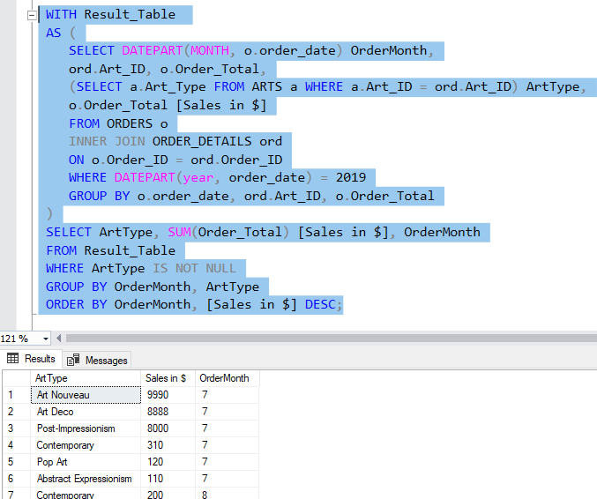
ARTS, ORDERS, ORDER_DETAILS
To list the most popular art_type for each month of 2019, considering all products sold in each month.
The most popular art_type had the highest total quantity sold for all products in that art.

Slide 27
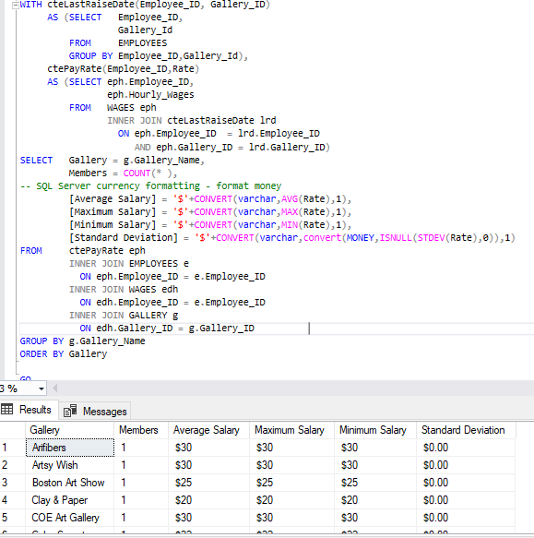
GALLERY, EMPLOYEES, WAGES
To calculate the average, maximum, minimum, and standard deviation of salary (pay rate) according to the gallery and number of employees working in the gallery.

Slide 28
STORED PROCEDURE

Slide 29
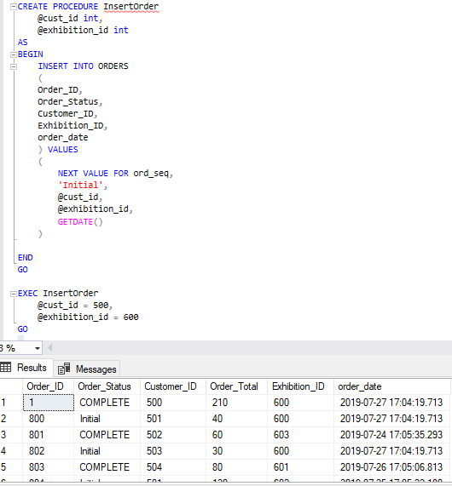
ORDERS PROCEDURE
InsertOrderProcedure: - To create a procedure which takes customer_id, exhibition_id as input parameters and insert the order into the ORDERS table associated with that customer_id and exhibition_id

Slide 30
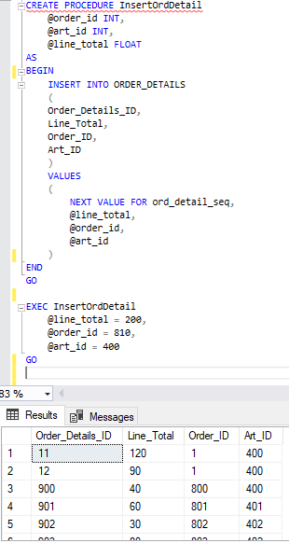
Order_details procedure
InsertOrderDetailProcedure: - To create a procedure which takes order_id, art_id, line_total as input parameters and insert the order details into the ORDER_DETAILS table associated with the input parameters.

Slide 31
VIEWS

Slide 32
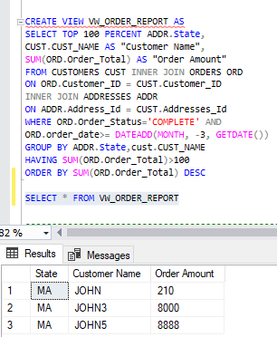
VW_ORDER_REPORT :
VW_ORDER_REPORT : Is a view to fetch results from existing Customers and Orders tables having Order_Status
As complete for the past 3 months with Ordert_Total greater than 100.

Slide 33
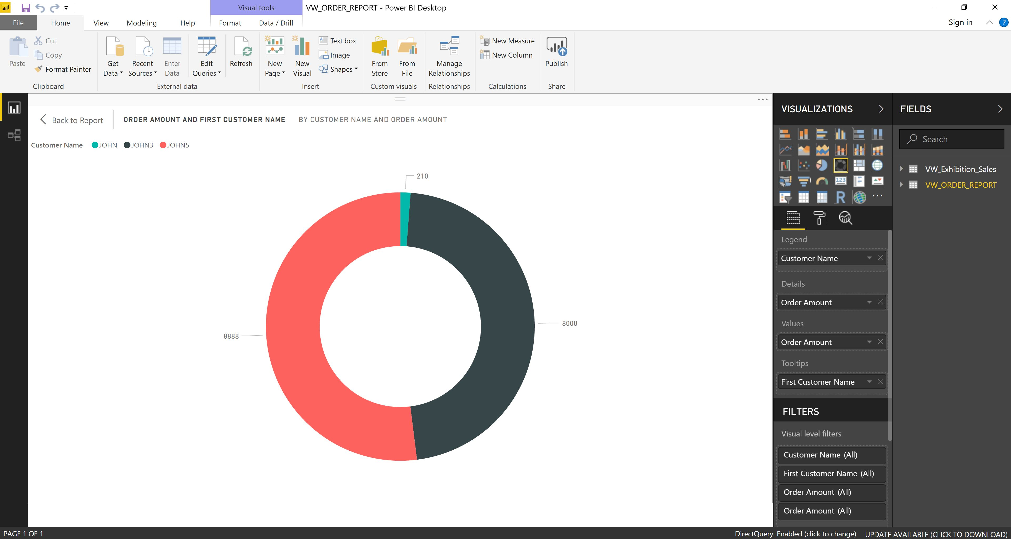

Slide 34
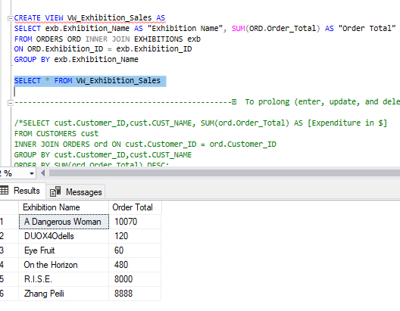
View VW_Exhibition_Sales
VW_Exhibition_Sales : is to create a view to fetch results from Exhibition and Orders tables as Exhibition Name and Order total.

Slide 35
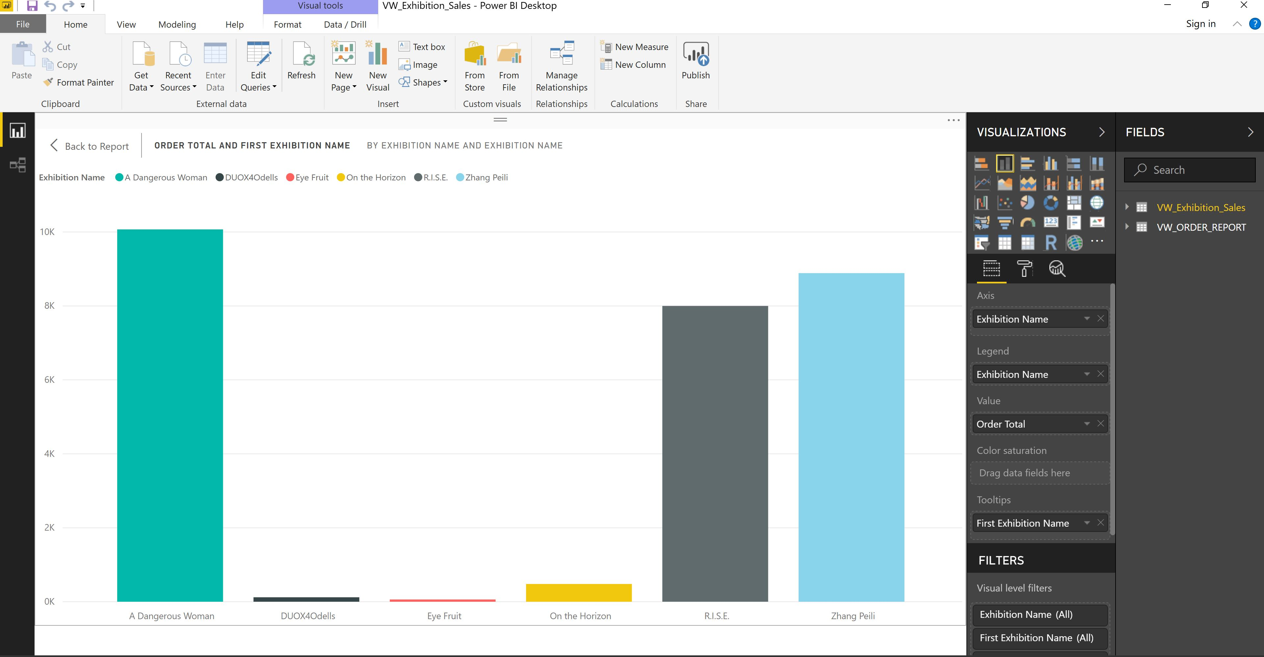

Slide 36
TAKE-AWAY
From this course, we learned how to communicate with relational database through TSQL(Transact Sequential Query Language)
Learned how to manipulate data and build queries that communicate with more than one table
Articulated concepts of ACID properties & principles of database transactions & triggering
Inculcated basic ethics of Team Management & how to communicate with your team peers
Defined the process of developing a fully-normalized database design

Slide 37
REFERENCES
Professor Wuping Wang
Connolly, T. M. & Begg, C. E., Database Systems: A Practical Approach to Design, Implementation, and Management
https://docs.microsoft.com/en-us/sql/t-sql/language-reference?view=sql-server-2017
https://www.w3schools.com/sql/

Slide 38
THANK YOU

